Slide 1

FINAL YEAR PROJECT
Violence Detection System
Using CNN-LSTM Models with MobileNetV2
Group Members:
Supervisor:
Rahul Mishra (2022030550)
Mr. Abhishek (Assistant Professor)
Anil Paneru (2022030505)
Panipat Institute of Engineering & Technology
Mahesh Karki (2022030533)

Slide 2


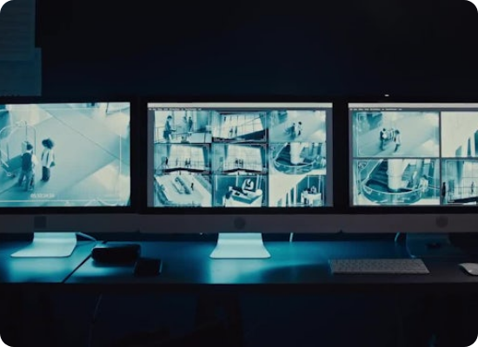
The Problem: Manual Surveillance
Current security relies heavily on human operators, leading to critical inefficiencies in real-world scenarios.
Slow & Unreliable: Humans cannot watch 20+ screens perfectly at once; distraction and error are inevitable.
Human Fatigue: Operators experience "mental fatigue" after staring at screens for hours, missing key incidents.
Reactive, Not Proactive: Humans usually react only after an event. We need a system that acts immediately.

Slide 3






Motivation & Objectives
Public Safety
Real-time Detection
Automated Alerting
Leveraging AI to support SDG 16: Peace, Justice, and Strong Institutions by making communities safer.
Identify violence in video streams instantly to reduce emergency response times significantly.
Implement immediate notifications and detailed incident logging so no one has to stare at a screen.

Slide 4

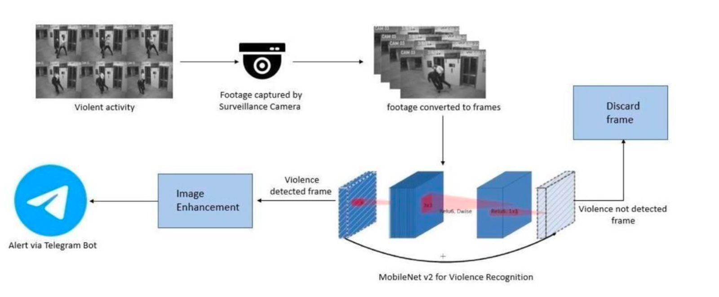
System Architecture
Input
CCTV cameras capture real-time video of an area.
The video footage is converted into individual frames for analysis.
Frame Processing
Each frame is sent to a MobileNetV2 model for violence recognition.
MobileNetV2 is a lightweight convolutional neural network used for image classification tasks
Classification
Violence Detected:
Frames containing violent activity are sent for image enhancement.
Enhanced frames are then used to send alerts via a Telegram bot to notify authorities.
No Violence Detected:
Frames without violent activity are discarded to save processing resources.
Alert System
The system sends instant notifications via Telegram Bot when violence is detected.

Slide 5
The Solution: Hybrid Architecture
MobileNetV2 (The Eyes): A lightweight CNN that extracts visual features efficiently.
+
LSTM (The Memory): A temporal network that understands sequence and motion over time.
"Like giving a lifeguard, a pair of magic binoculars that automatically points out anyone struggling."

Slide 6
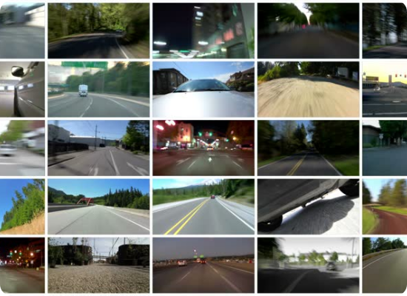
The Training Data
Comprehensive Learning
To teach the AI, we curated a comprehensive dataset specifically for action recognition.
Diverse Scenarios: Includes varied environments (streets, indoors) and authentic lighting conditions.
Balanced Data: Crucially includes both violent and non-violent actions so the AI distinguishes subtle nuances.
Analogy: Teaching a child "dog" vs "cat" requires showing examples of both.

Slide 7

Step 1: Spatial Analysis (MobileNetV2)
Why MobileNetV2?
The "Eyes"
Standard CNNs are heavy. MobileNetV2 is "lightweight," designed to work fast on normal computers and edge devices, ensuring real-time performance.
What it does: MobileNetV2 scans individual frames to extract "visual patterns."
How it works: Like a human eye recognizing shapes, it identifies objects like "an arm," "a leg," or "a fist." It understands what is happening in a single static picture (Space/Spatial).
FAST
EFFICIENT

Slide 8


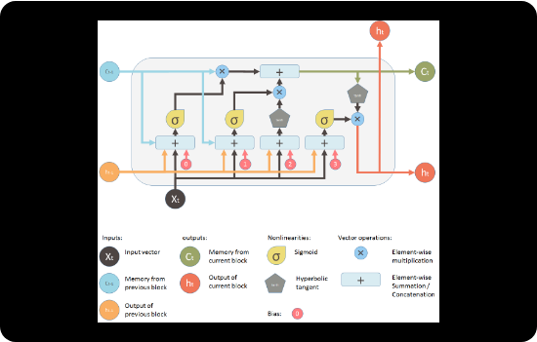
Step 2: Temporal Analysis (LSTM)
The "Memory"
What it does: LSTM processes the sequence of features over time.
The Analogy: A photo of a fist near a face isn't necessarily violence (it could be a high-five). The LSTM remembers previous frames to track motion, understanding that the fist is moving fast and forcefully.

Slide 9
Methodology Pipeline
1. Load
2. Process
3. Extract
4. Analyze
5. Alert
Input Video
Frame Extraction
MobileNet Features
LSTM Temporal Check
Log & Notify

Slide 10


Technology Stack
Hardware Specs
Software Stack
Optimized for standard computing with optional GPU acceleration.
Built on robust, open-source AI libraries.
Language: Python 3.x
CPU: i5/i7 or Ryzen
Core AI: TensorFlow & Keras
RAM: 8-16 GB
Vision: OpenCV
GPU: Recommended for real-time inference speed

Slide 11


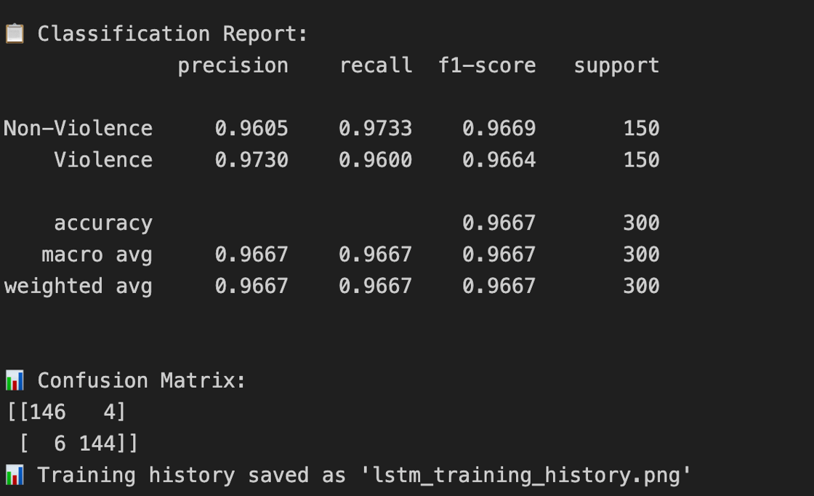

System Performance
96.7%
97.30%
Accuracy
Precision
96.00%
Recall
Rigorous testing demonstrated high reliability, with minimal false positives for "playful actions."

Slide 12


Challenges & Future Scope
Current Challenges
Future Enhancements
Low-light Conditions: Accuracy drops in poorly lit environments.
Weapon Detection: Integrating object detection for guns/knives.
False Positives: Sports or "play fighting" can occasionally be misclassified as violence.
Audio Fusion: Adding "ears" to hear screams or crashes for confirmation.

Slide 13


Conclusion
We have successfully developed a hybrid CNN-LSTM system capable of efficient, real-time violence detection.
A strong foundation for AI-driven surveillance and safer communities.

Slide 14
Questions?
Thank you for your attention.

Slide 15






Image Sources
https://motionarray.imgix.net/digital-cctv-surveillance-screens-in-dark-control-room-of-hotel-2907784-high_0010.jpg?w=660&q=60&fit=max&auto=format
Source: motionarray.com
https://images.stockcake.com/public/d/7/5/d750ec8a-af52-47b8-88c6-a7d1285da280_large/neural-network-visualization-stockcake.jpg
Source: stockcake.com
https://media.istockphoto.com/id/129929951/video/video-montage-driving.jpg?s=640x640&k=20&c=tdvRrXz5YLoSMqCGI0uS8wp_Vpjltm5tsFIVyj1QTe0=
Source: www.istockphoto.com
https://miro.medium.com/1*laH0_xXEkFE0lKJu54gkFQ.png
Source: blog.mlreview.com
https://media.assettype.com/analyticsinsight%2Fimport%2Fwp-content%2Fuploads%2F2020%2F12%2FCybersecurity.jpg?w=480&auto=format%2Ccompress&fit=max
Source: www.analyticsinsight.net

